Slide 1

TEAM SOFTWARE PROCESS
BY,
SARVESH D. GAONKADKAR

Slide 2

Agenda
INTRODUCTION
1
HOW TSP WAS DEVELOPED
2
AN OPERATIONAL TEAM PROCESS
3
STRUCTURE OF TSP
4
LAUNCHING A TSP TEAM
5
THE TSP TEAMWORKING PROCESS
6
CONCULSION
7

Slide 3

INTRODUCTION
1
Team Software Process (TSP) is a comprehensive approach to software development that focuses on improving the quality, productivity and predictability of engineering teams.
It aids engineering teams in developing software intensive products.
It is designed for teams ranging from 2 to 20 members

Slide 4

The objectives of TSP are:
The TSP is intended to improve the levels of quality and productivity of a team's software development project.
Using TSP, organizations establish a mature and disciplined engineering practice that produces secure, reliable software in less time and at lower costs.
Show managers how to coach and motivate their teams and how to help them to sustain peak performance.
Build self directed teams that plan and track their work, establish goals, and own their processes and plans. To form a self directed team, you must collaborate well internally and communicate well externally.

Slide 5
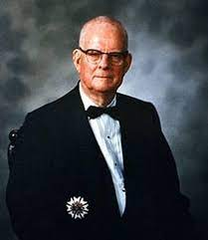
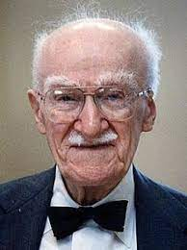


HOW TSP WAS DEVELOPED
2
BACKGROUND
W. Edwards Deming
J M. Juran
Michael Fagan
Watts S. Humphrey
software development process
1976
Capability Maturity Model (CMM) in 1987 and the Personal Software Process (PSP) in 1995
quality improvement strategy

Slide 6
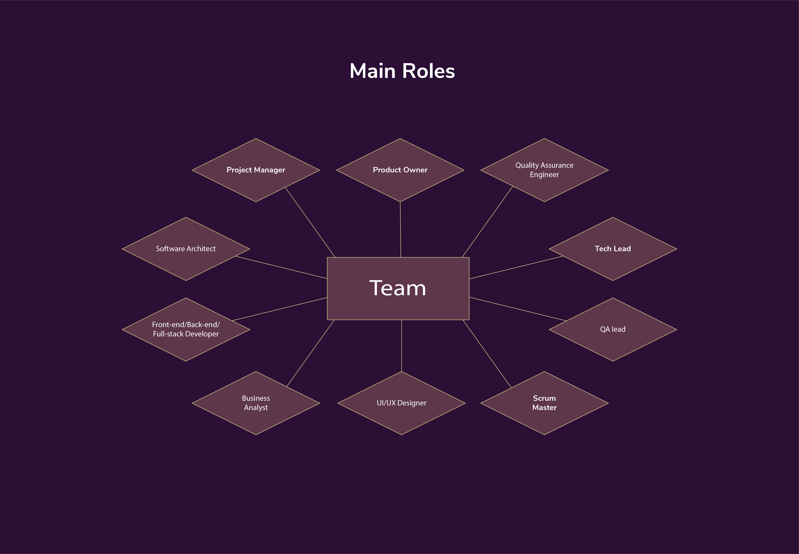
HOW TSP WAS DEVELOPED
2
2.1 ENGINEERING TEAMWORK
Let's look what is a development team responsible for. The talents in the software development team include the following:

Slide 7
HOW TSP WAS DEVELOPED
2
2.2 The Conditions for Teamwork
A team consists of at least two people.
The members are working toward a common goal.
Each person has a specific assigned role.
Completion of the mission requires some form of dependency among the group members.

Slide 8
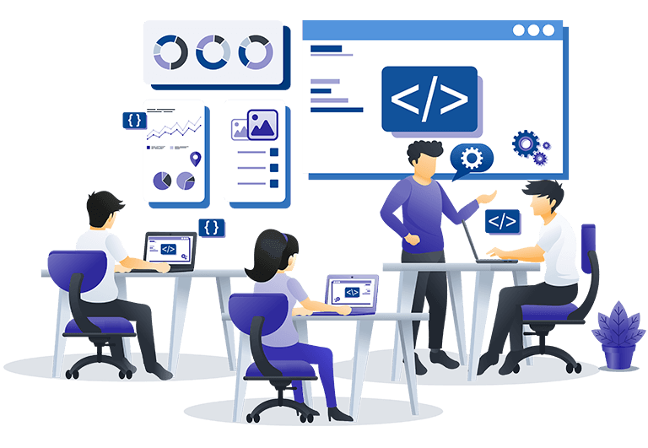
HOW TSP WAS DEVELOPED
2
2.3 Effective Teams
To be effective, teams must be properly skilled and be able to work as cohesive units. Effective teams have certain common characteristics:
The members are skilled.
The team’s goal is important, defined, visible, and realistic.
The team’s resources are adequate for the job.
The members are motivated and committed to meeting the team’s goal.
The members cooperate and support each other.
The members are disciplined in their work.

Slide 9
HOW TSP WAS DEVELOPED
2
2.4 Building Effective Teams
The team members establish common goals and defined roles.
The team develops an agreed-upon strategy.
The team members define a common process for their work.
All team members participate in producing the plan, and each member knows his or her personal role in that plan.
The team negotiates the plan with management.
Management reviews and accepts the negotiated plan.
The team members do the job in the way that they have planned to do it.
The team members communicate freely and often.
The team forms a cohesive group: the members cooperate, and they are all committed to meeting the goal.
The engineers know their status, get feedback on their work, and have leadership that sustains their motivation.

Slide 10

AN OPERATIONAL TEAM PROCESS
3
Personal Software Process (PSP):
It focuses on improving the individual developer's skills and productivity.
Key Components:
Time Management: Helps developers learn how to plan and track their work.
Defect Management: Focuses on finding and fixing defects in the early stages of development.
Size Estimation: Teaches techniques for estimating the size and effort required for a project.
Team Software Process (TSP):
It is designed to improve the quality and productivity of software development teams.
Key Components:
Team Launch: Formation of a team and assignment of roles and responsibilities.
Planning: Detailed planning of the project, including schedules and quality goals.
Tracking and Reporting: Monitoring progress, defects, and other project metrics.
Post-Mortem: An analysis of the project after completion to learn from successes and failures.
Capability Maturity Model (CMM):
The Capability Maturity Model is a framework for assessing and improving the maturity of an organization's software development processes.
Maturity Levels: CMM defines five maturity levels:
Initial: Chaotic and ad-hoc processes.
Repeatable: Basic project management practices.
Defined: Defined and documented processes.
Managed: Quantitatively managed processes with performance metrics.
Optimizing: Continuous process improvement.

Slide 11
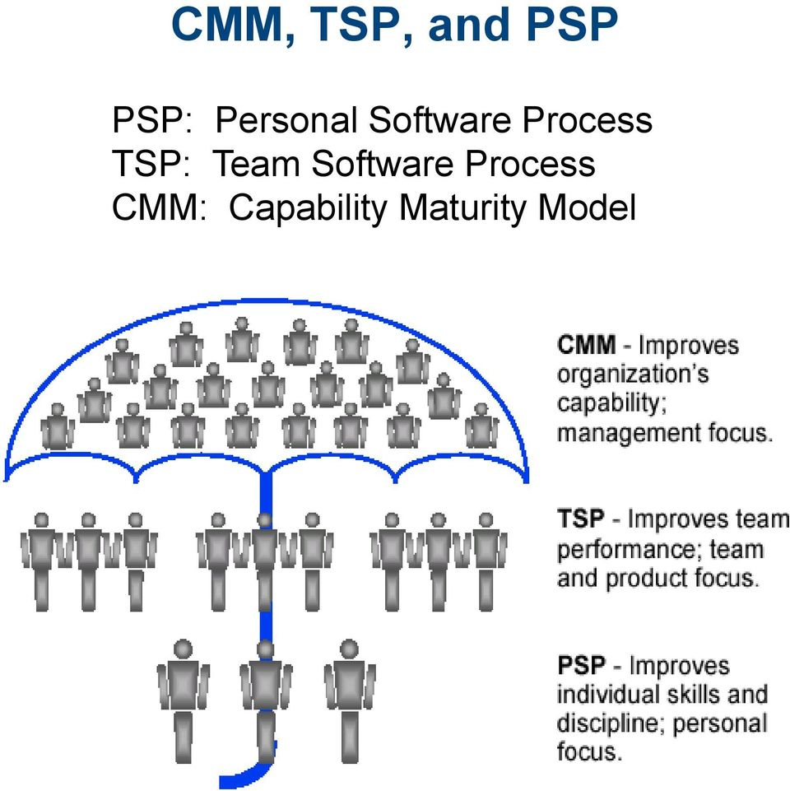
AN OPERATIONAL TEAM PROCESS
3
The TSP provides the operational processes needed to form engineering teams, to establish an effective team environment, and to guide teams in doing the work.

Slide 12
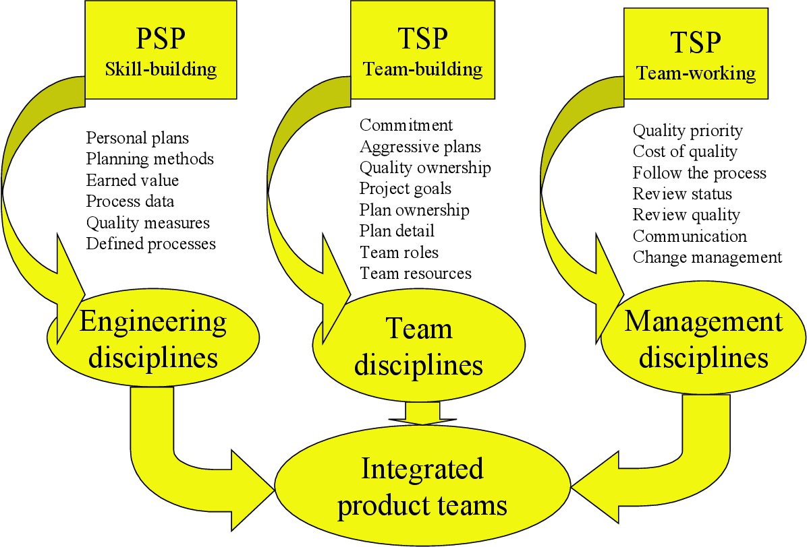
STRUCTURE OF TSP
4

Slide 13
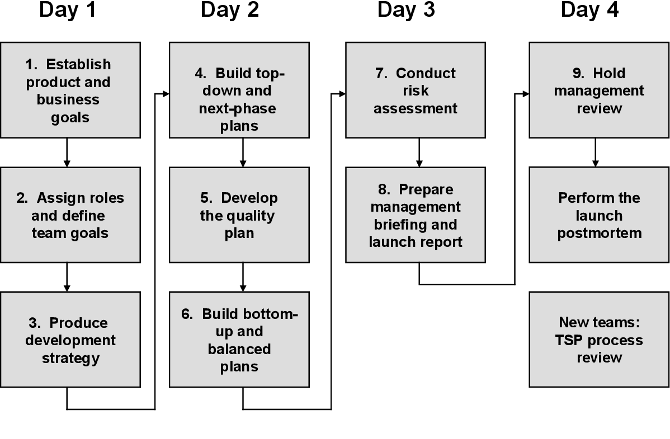
LAUNCHING A TSP TEAM
5

Slide 14
Once the TSP team is launched, the principal need is to ensure that all team members follow the plan. This includes the following major topics:
Leading the team
Process discipline
Issue tracking
Rebalancing team workload
Communication
Management reporting
Maintaining the plan
Estimating project completion
Relaunching the project
TSP quality management
THE TSP TEAMWORKING PROCESS
6

Slide 15
THE TSP TEAMWORKING PROCESS
6
LEADING THE TEAM
Guides team members
Handles customer issues
Deals with management
Directs work, protects team resources, resolves team issues, conduct team meetings, etc
Maintains the teams motivation and energy and ensures that it is fully effective in doing its work

Slide 16


THE TSP TEAMWORKING PROCESS
6
COMMUNICATION
Keeping team members and management informed
Weekly reviews from team members
Weekly reports to management
MAINTAINING THE PLAN
Track progress using earned values
Helps team members see where they are and helps the management to see what needs to be done
Dose not priorities and dependencies

Slide 17

THE TSP TEAMWORKING PROCESS
6
REBALANCING TEAM WORKLOAD
Some team members will have too much to do, some will have little
Its more efficient for each team member to be fully occupied
Team may have to rebalance the workload as often as once a week

Slide 18
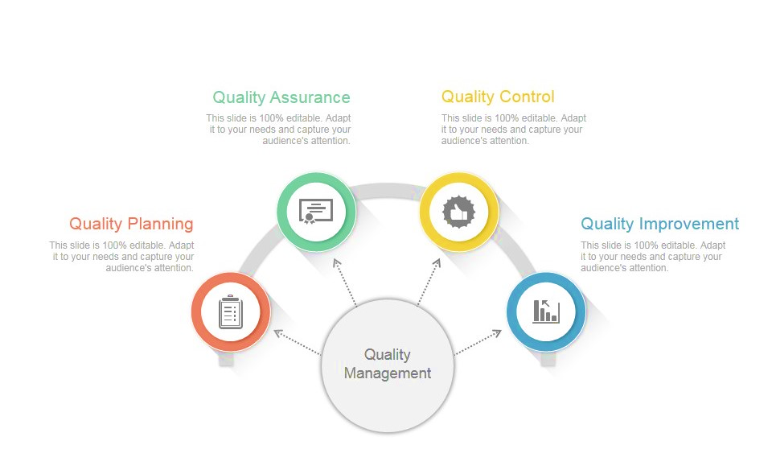
QUALITY MANAGEMENT
Set goals and Implement them
Measure progress against the plan
Make a quality plan
Identifying quality problems using charts

Slide 19

CONCULSION
7
The Team Software Process (TSP) is a comprehensive framework designed to foster effective teamwork, enhance product quality, and improve project management in software-intensive engineering projects. Its roots in Total Quality Management (TQM), alignment with the Capability Maturity Model (CMM), and emphasis on disciplined processes make it a valuable approach for organizations seeking to achieve excellence in software development. By understanding and implementing the principles and practices of TSP, engineering teams can consistently deliver high-quality software products while meeting cost and schedule commitments.

Slide 20

REFERENCE :
https://insights.sei.cmu.edu/documents/645/2000_005_001_13754.pdf
Team Software Process (TSP) – In Short – EDUINDEX NEWS
Team software process - CodeDocs

Slide 21


